Slide 1
Embedded and Real-Time Systems (EENG 34030): Main Problem Submission Group 6
Qijia Tang dm22509
Ronaldo Balram nz20469
Khush Shah bi20475
Kalyan Sudra eo20203

Slide 2
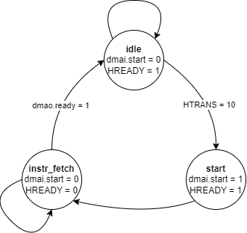
State machine flowchart:

Slide 3
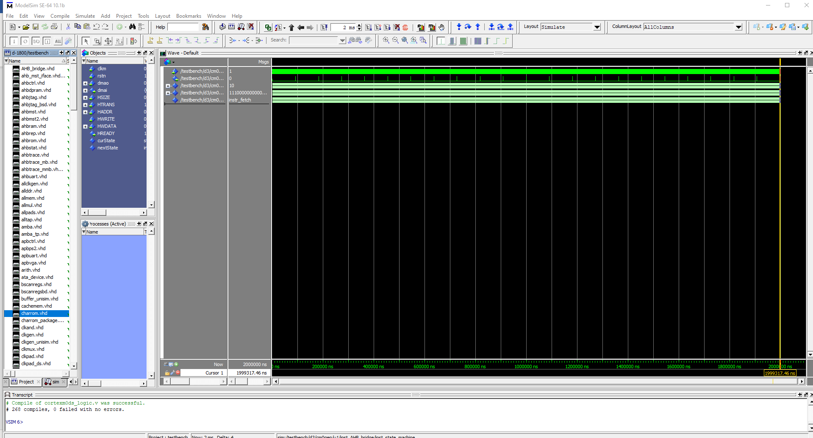
Screencap of simulation waveform:

Slide 4
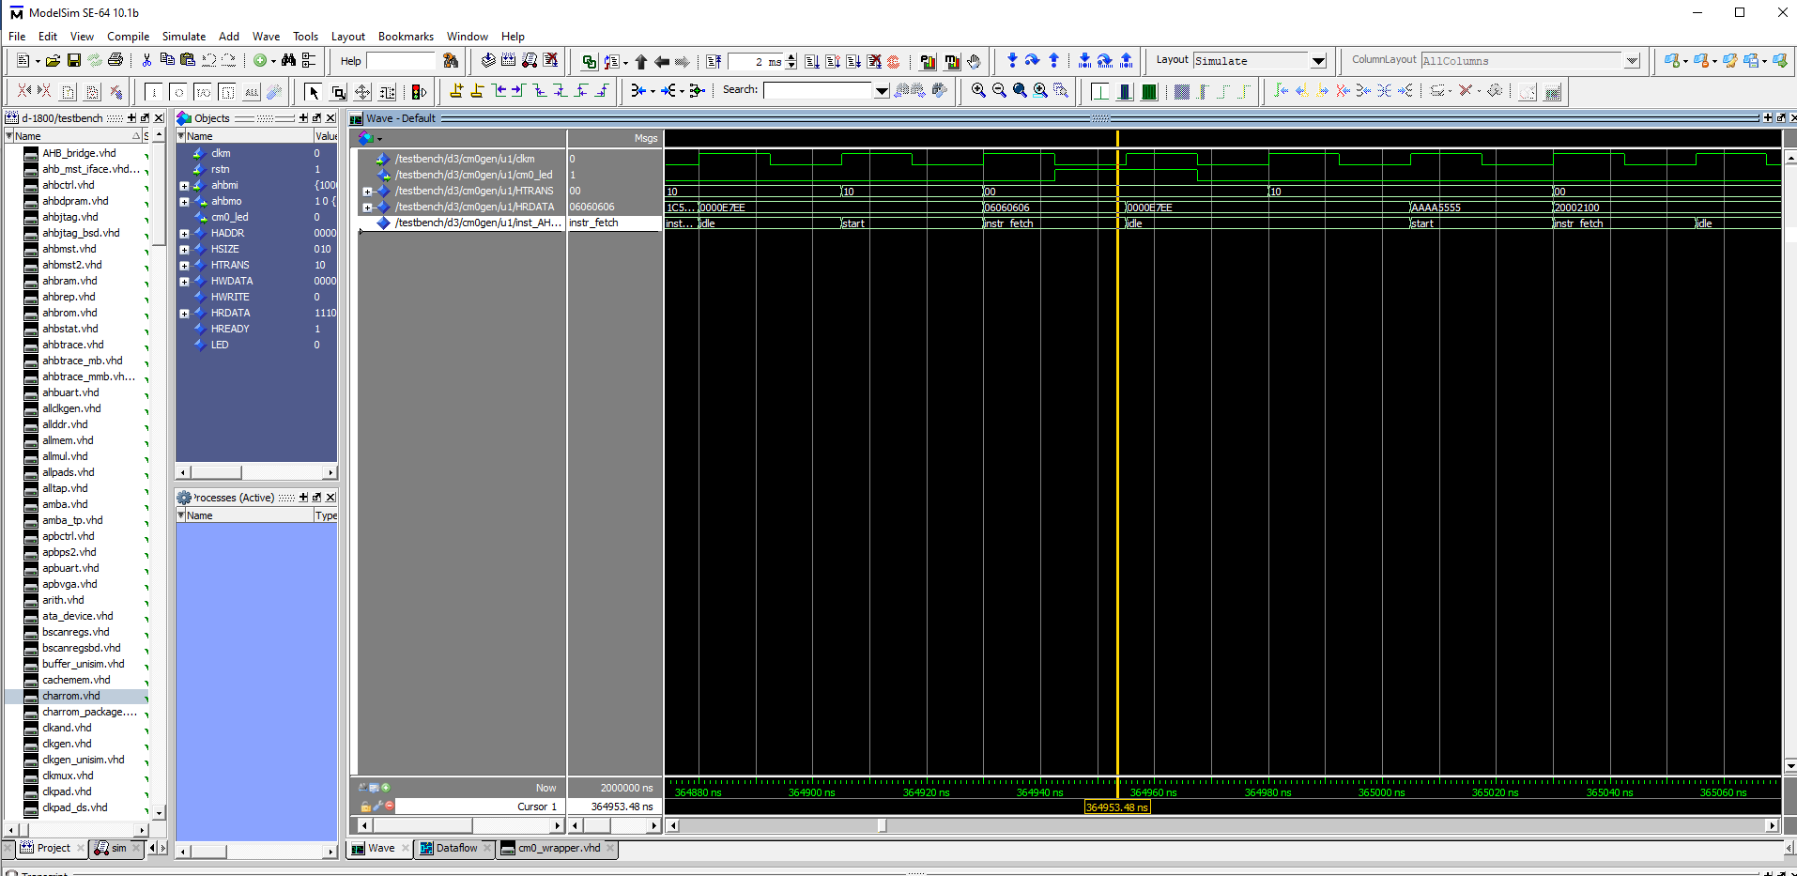
Screencap with group number

Slide 5
FPGA Implementation Details Table:
FPGA device selected: | Spartan 6 xc6slx100-3fgg676
Total Number of occupied Slices: | 1193
Total Number of Slice Flip Flops: | 841
Total Number of Slice LUTs: | 3122
Best possible clock frequency: | 57MHz

Slide 6
Screencap of waveform with delays:

Slide 7
Design Checklist:
Check swapper and state machine VHDL code, check clock usage and correct combinational and sequential processes.
Verify VHDL code for hierarchy that should include AHB bridge, processor etc. Check components inside AHB bridge are correctly connected and look complete.
Show that the simulator compiles the VHDL code without errors.

Slide 8
Design Checklist:
Show that the simulator loads the system VHDL without errors and testbench starting.
Show that the Cortex-M0 processor is running without entering undefined states.
Show that the processor is running continuously without halting after some time.
Show that the data patterns that trigger the led blinking appear in the HRDATA signal (your group number).

Slide 9
Design Checklist:
Show that the data patterns in HRDATA signal that trigger the led blinking are repeating periodically. (It should repeat once every ~62000 ns)
Show that the data patterns in HRDATA that trigger the led blinking repeating periodically are connected to a new user defined output in the testbench such as led.

Slide 10
Implementation Checklist:
Check Vivado/ISE project for code completeness and correct Leon3 library set up. Does your design satisfy timing constraints?
Check the implementation reports and FPGA Implementation Details Table.
Show the simulation of the netlist with additional timing data (SDF files) working correctly with led blinking repetitions.

